Slide 1
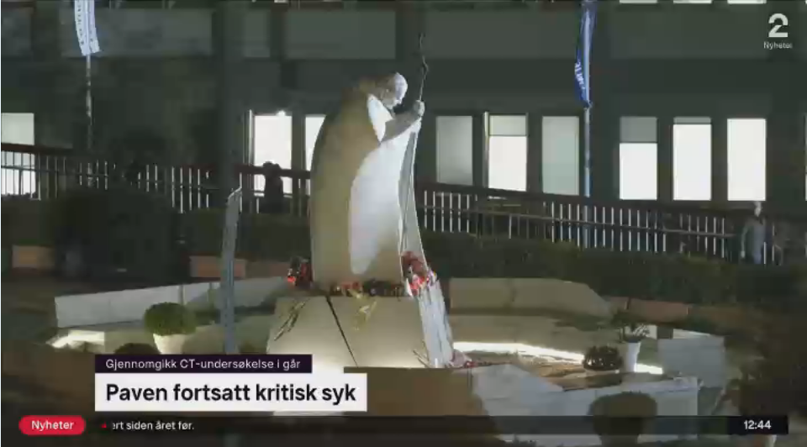
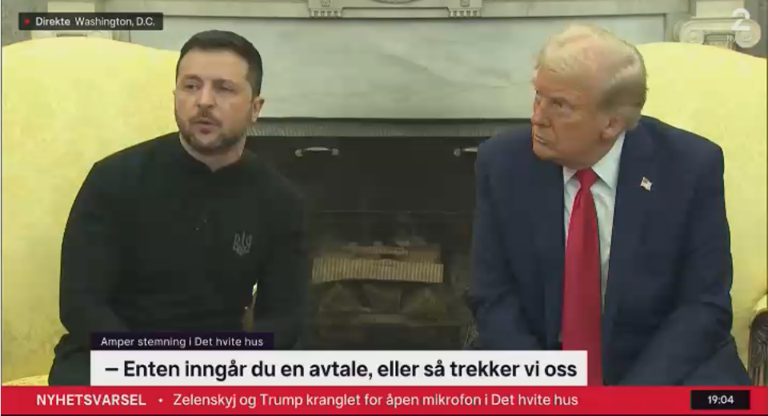
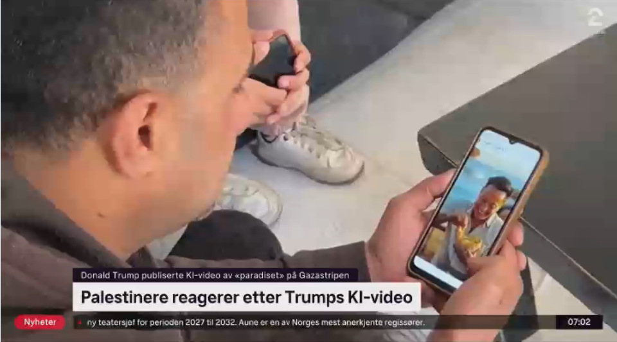
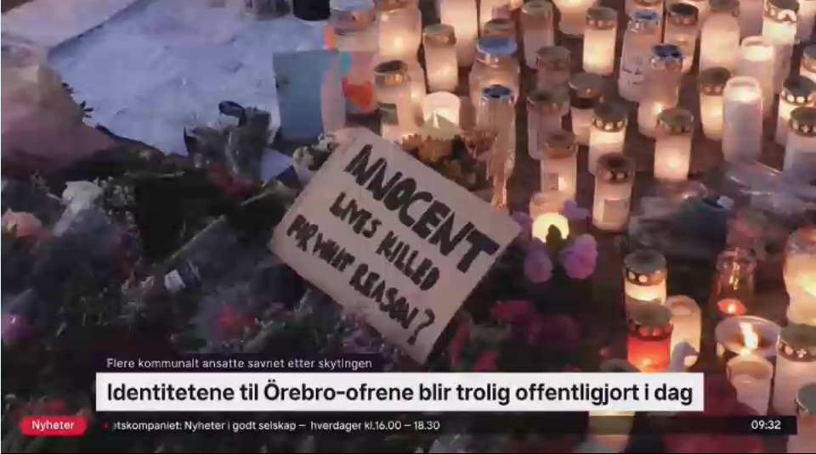
TV2 Norway’s use of Reuters video has more than doubled in 18 months, driven by the Mideast, Ukraine, and Donald Trump. The sharp rise in usage may be set to continue as the West enters a new uncertain era.
In the year-to-date TV2 used 13% of all material, TV2 News 87%.
Lives 403/On air 160
Total 2449 edits from 150 countries
Total time on air 11 days 20 hours.
Major stories
Gaza: 24%
Ukraine: 9%
Trump: 9%
Of detections of all Reuters video.

